Slide 1
TESTING

Slide 2
BACK-END CONTROLLERS

Slide 3

ADMIN CONTROLLERS

Slide 4
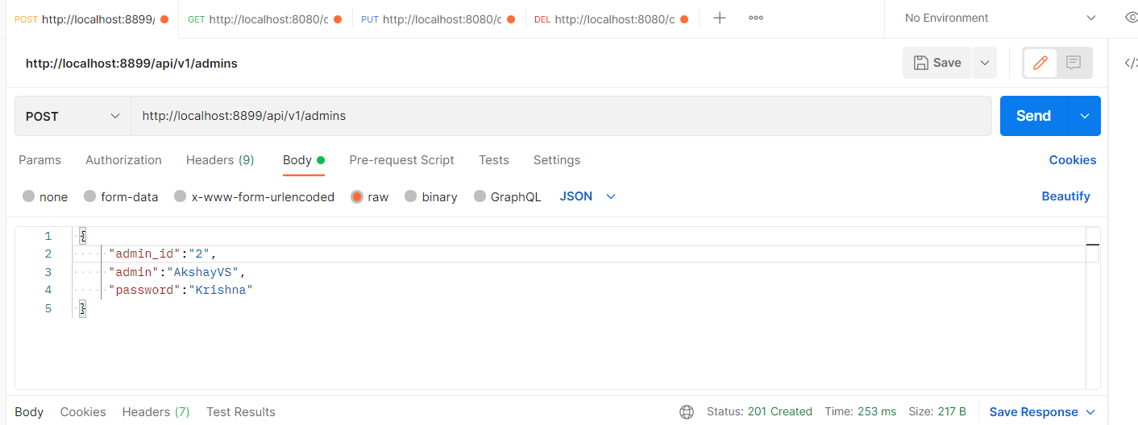

Slide 5
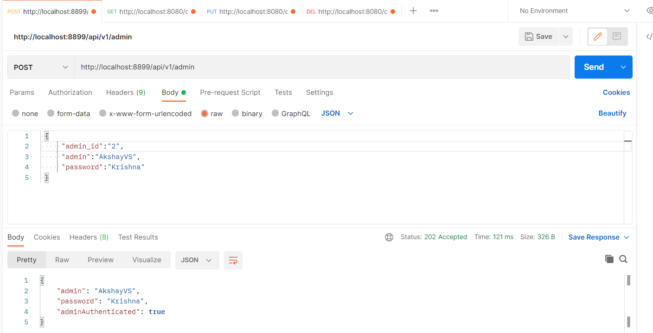

Slide 6

USER CONTROLLERS

Slide 7
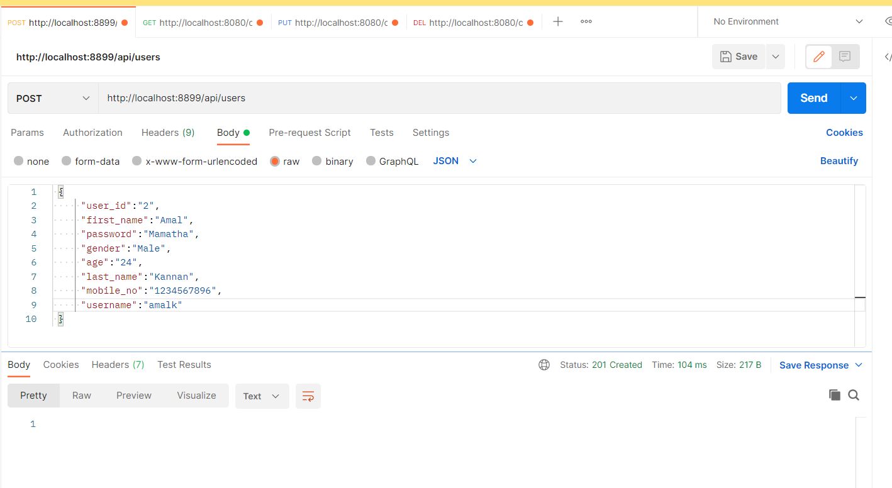

Slide 8
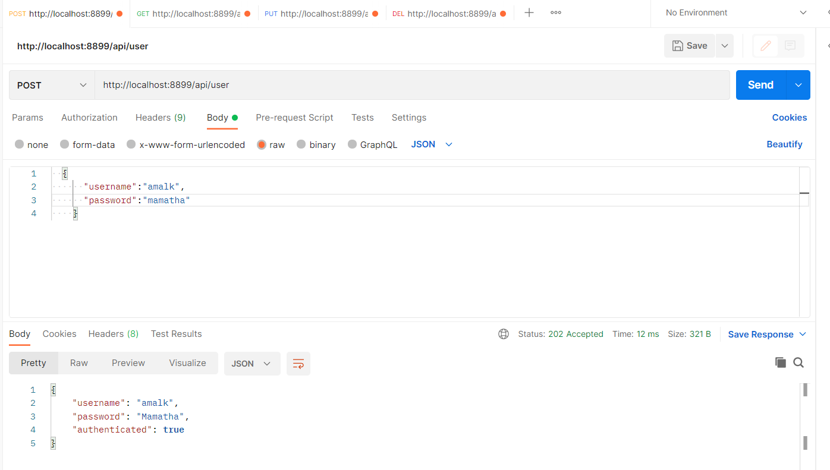

Slide 9
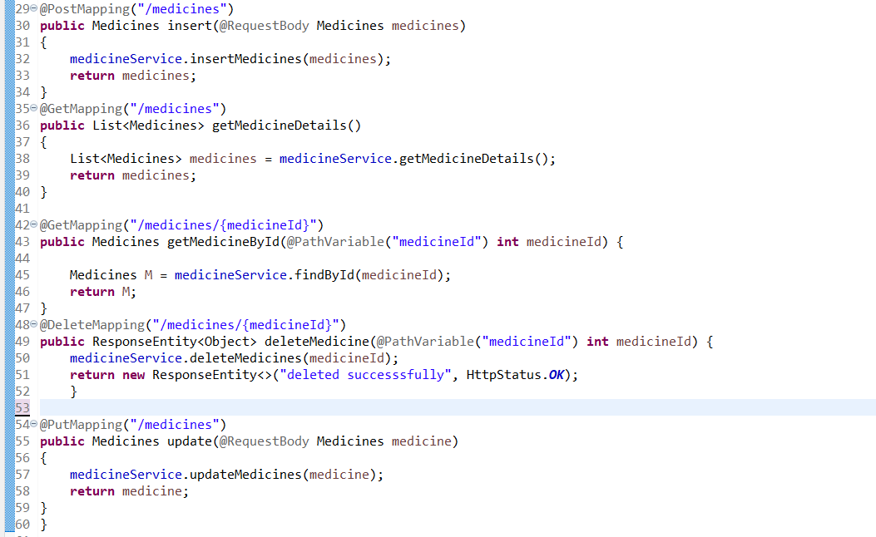
MEDICINE CONTROLLER

Slide 10
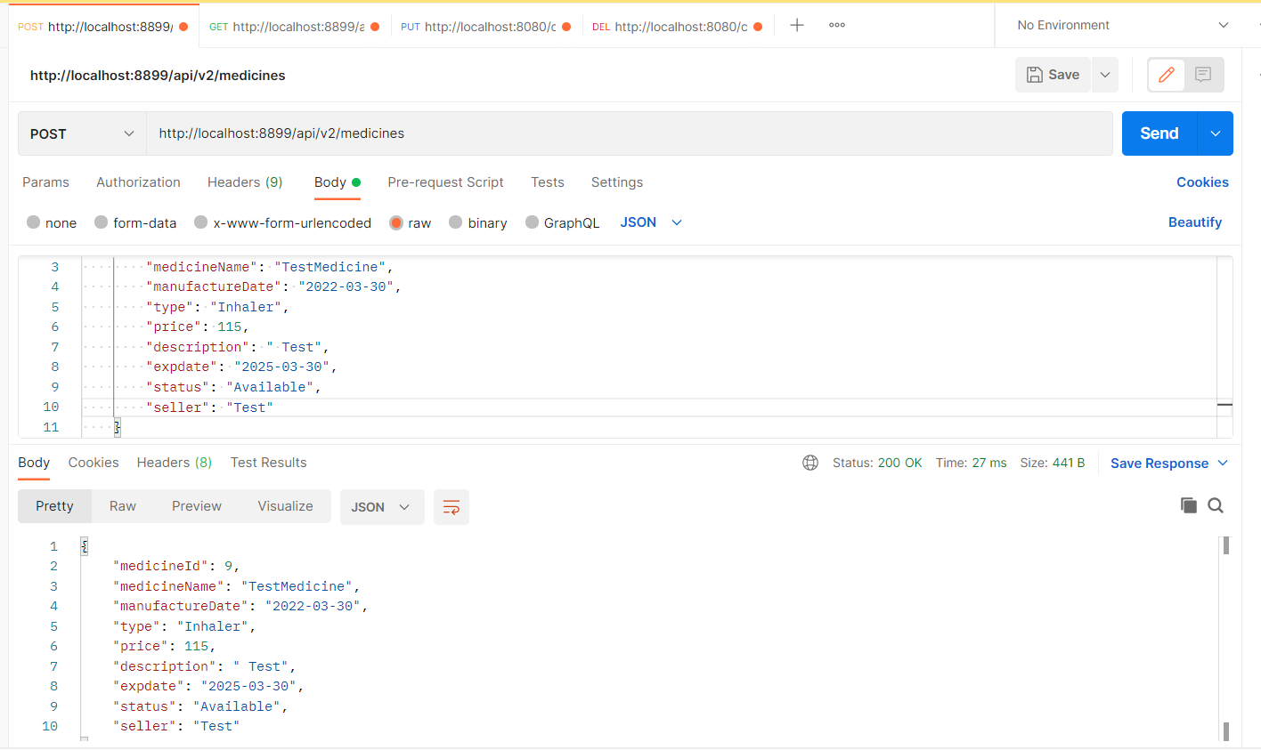

Slide 11
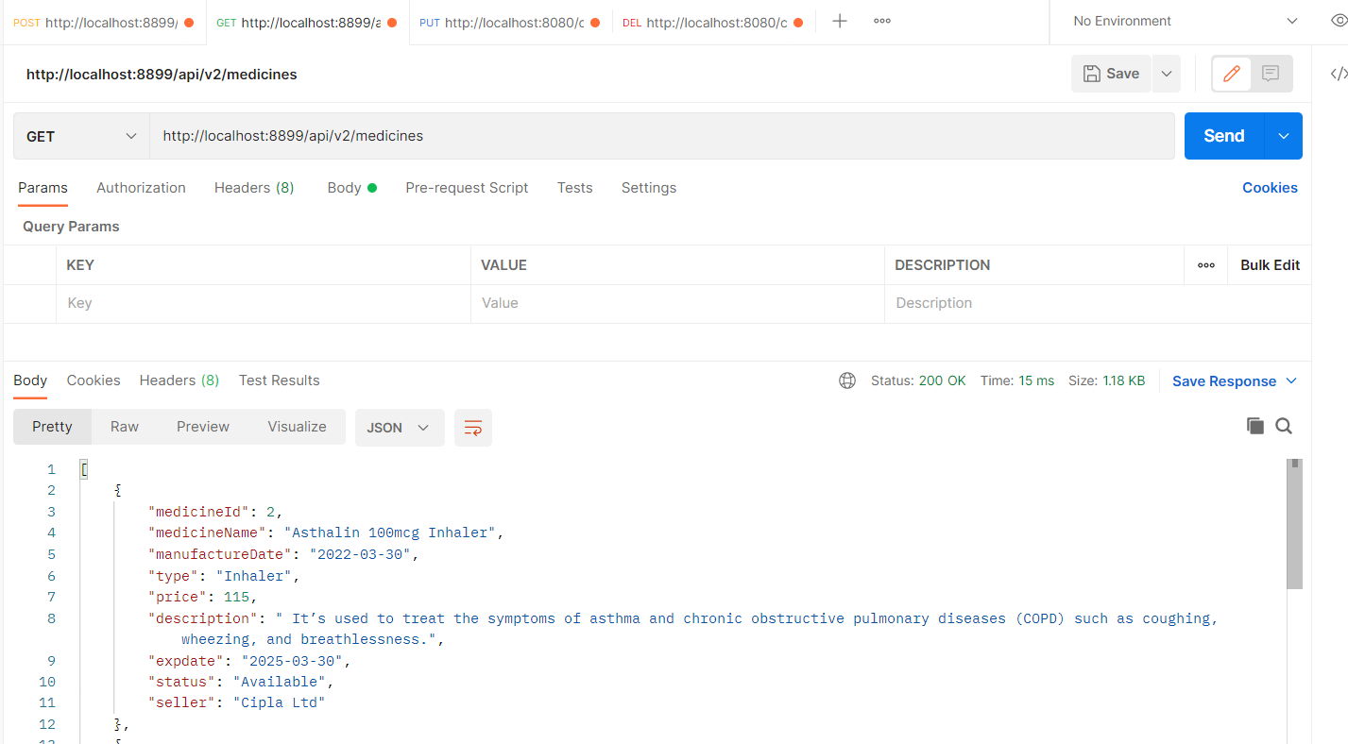

Slide 12
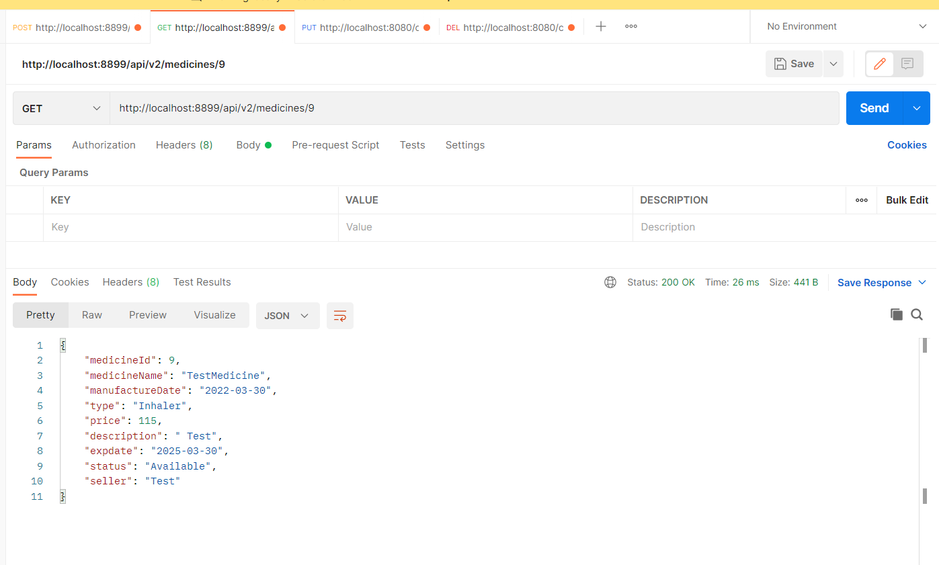

Slide 13
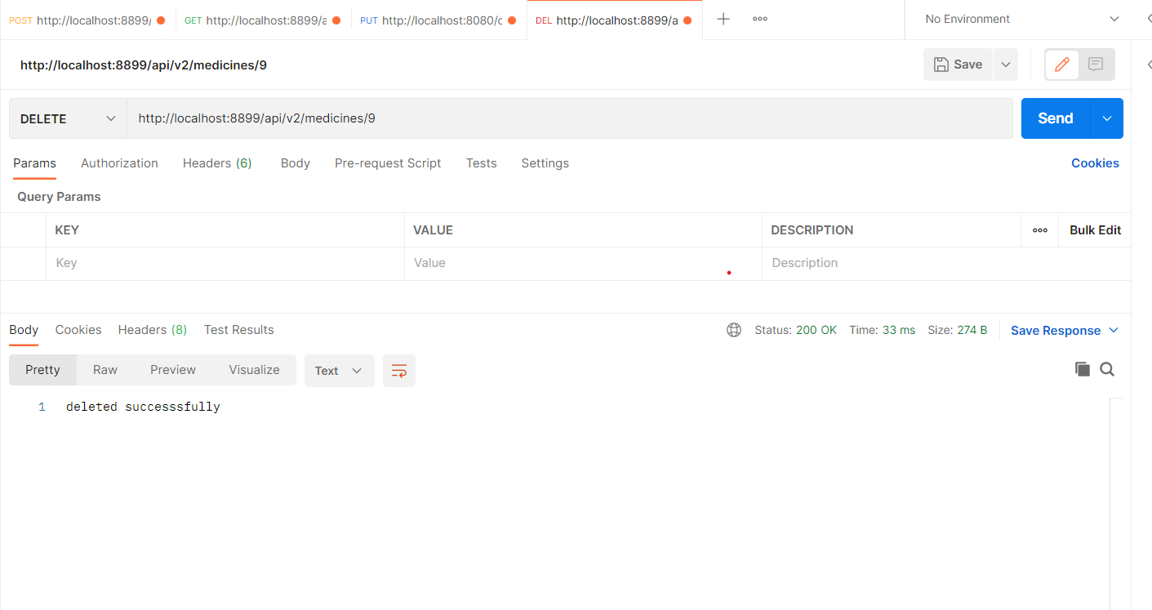

Slide 14
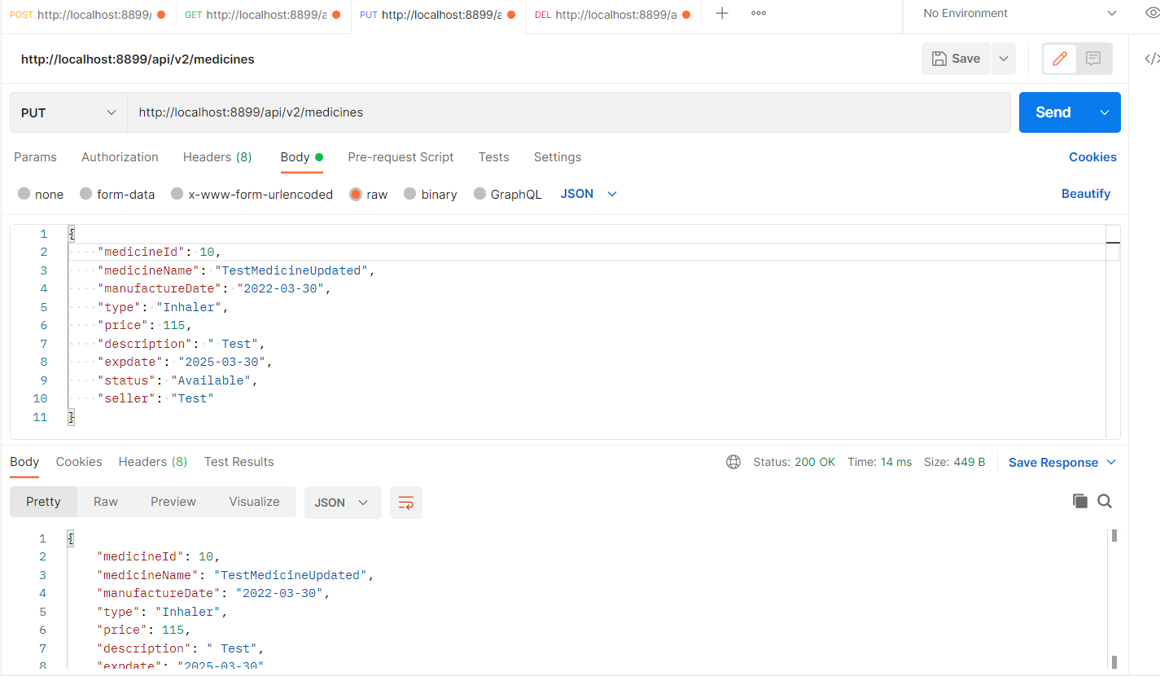

Slide 15
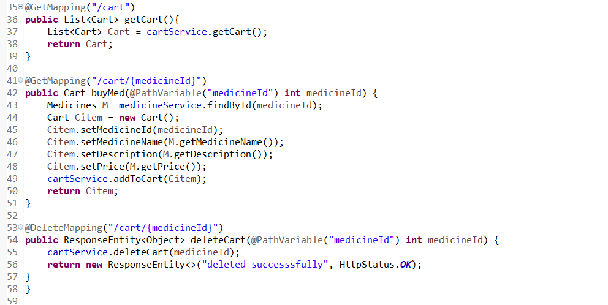
CART CONTROLLER

Slide 16
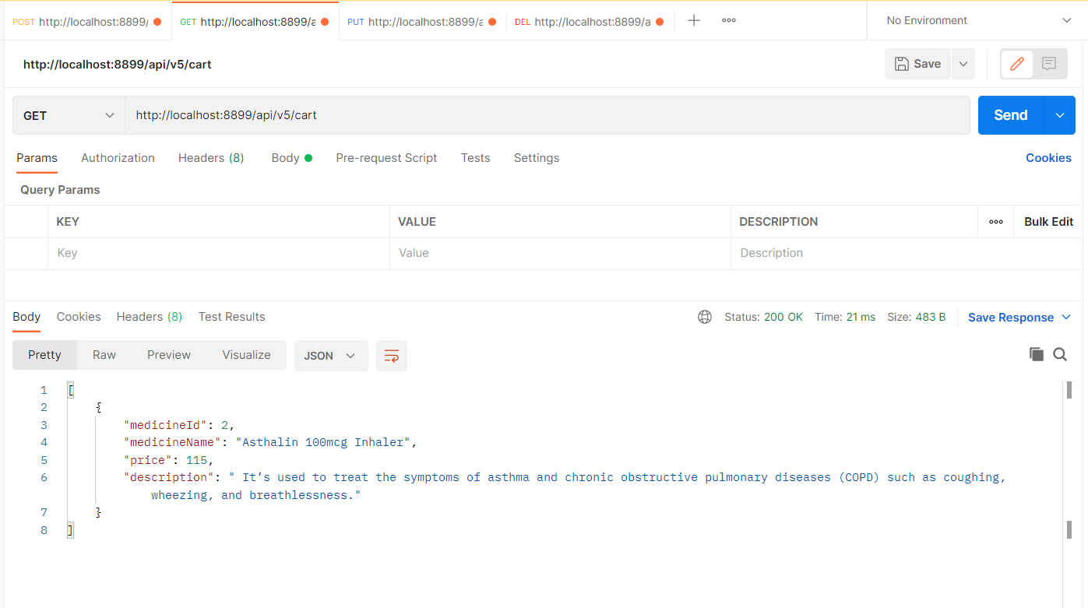

Slide 17
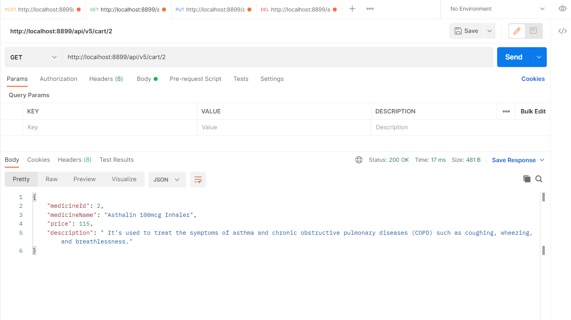

Slide 18
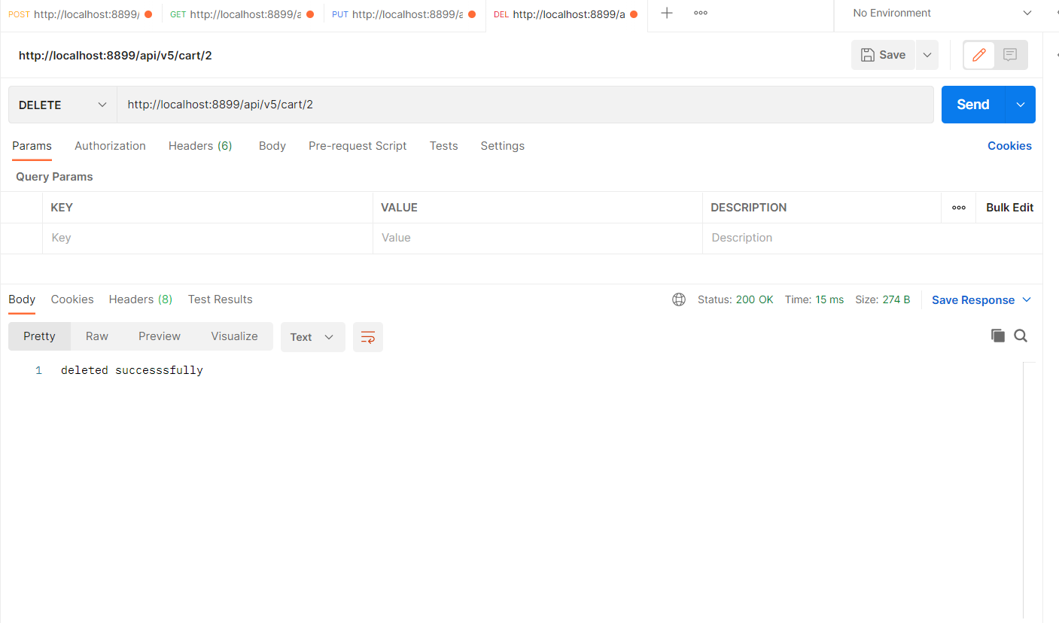

Slide 19
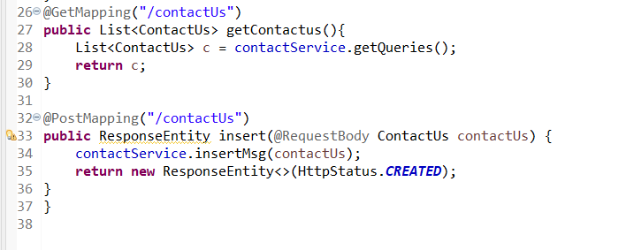
CONTACT US CONTROLLER

Slide 20
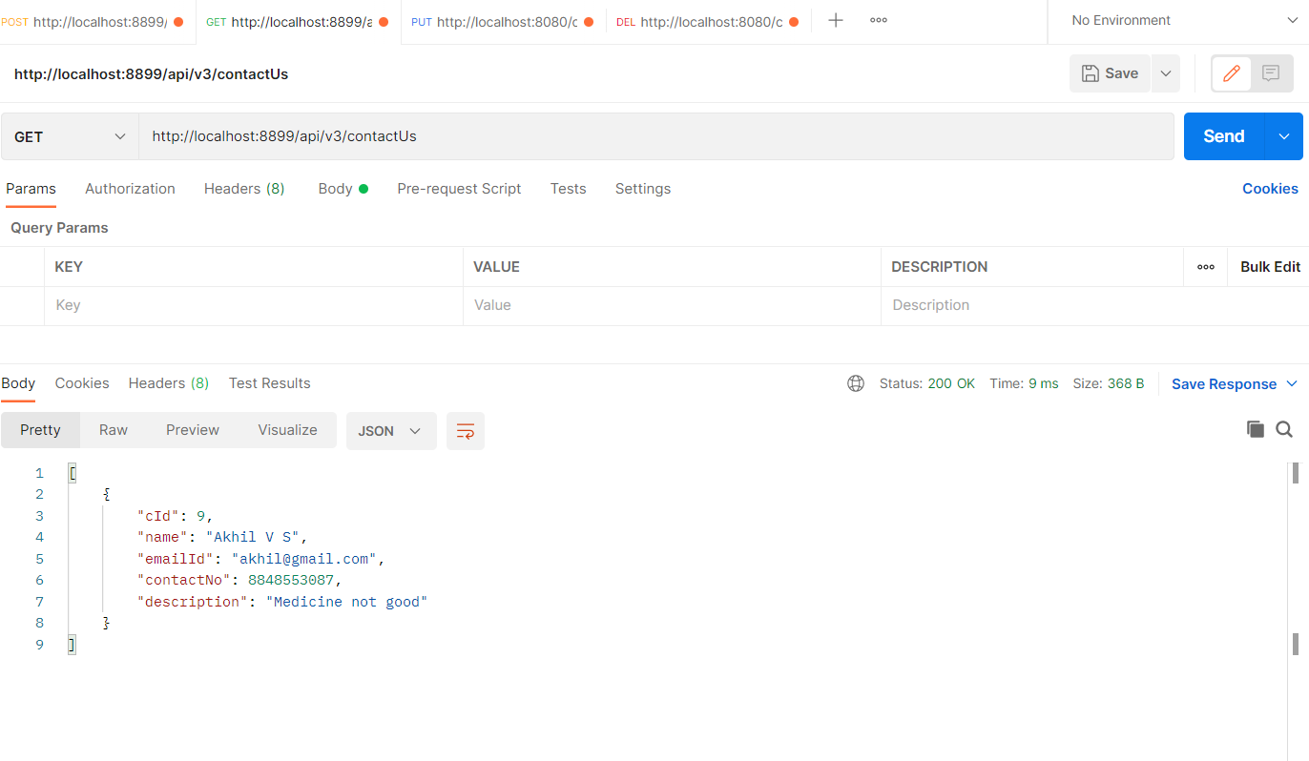

Slide 21
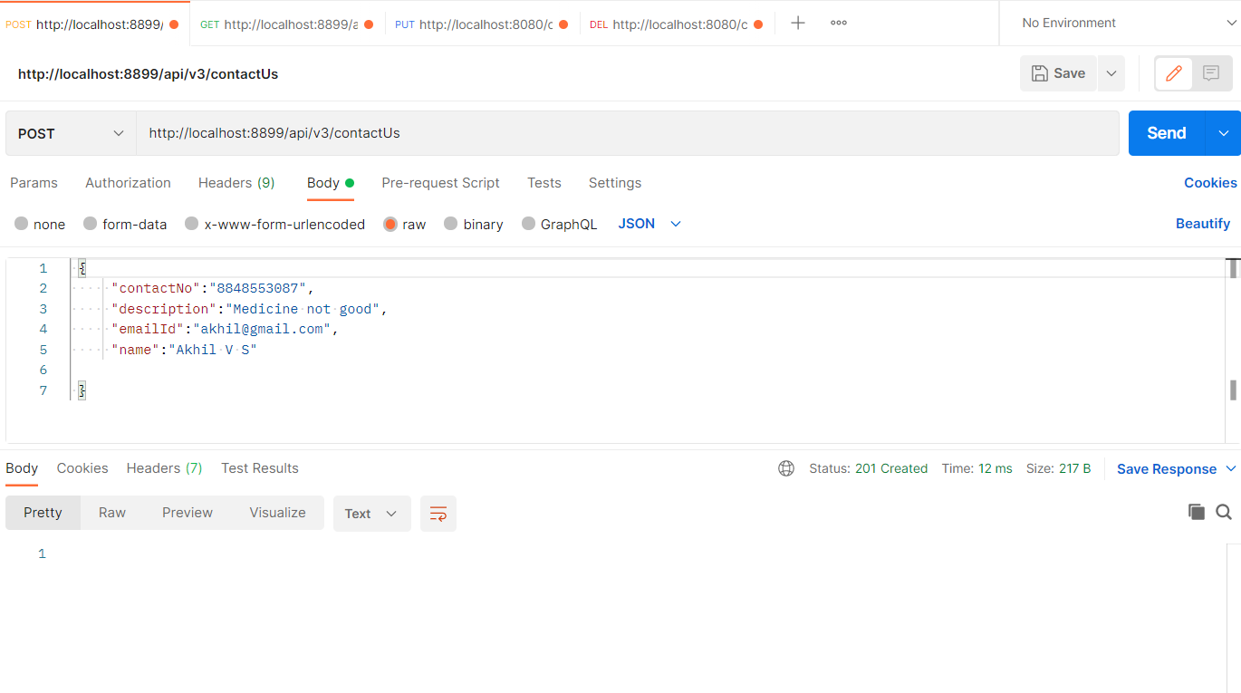

Slide 22
SELENIUM TestNG CODES

Slide 23
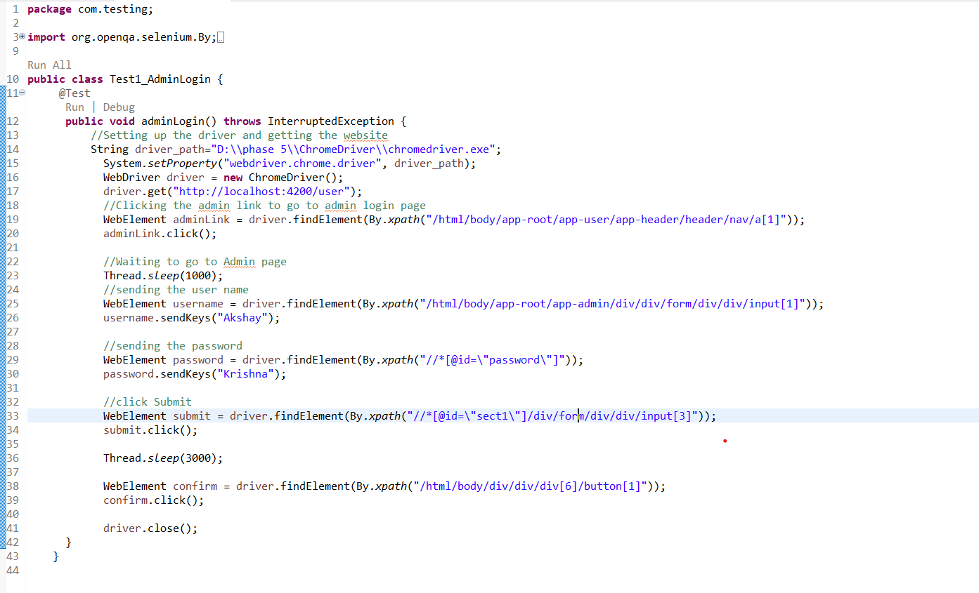
ADMIN LOGIN TEST

Slide 24
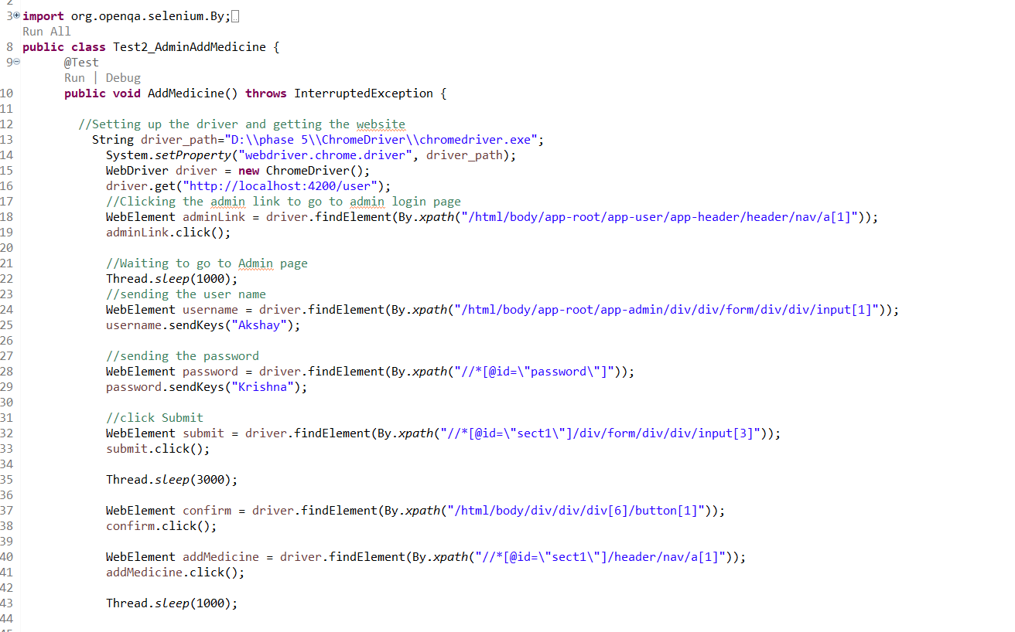
ADMIN ADD MEDICINE TEST

Slide 25
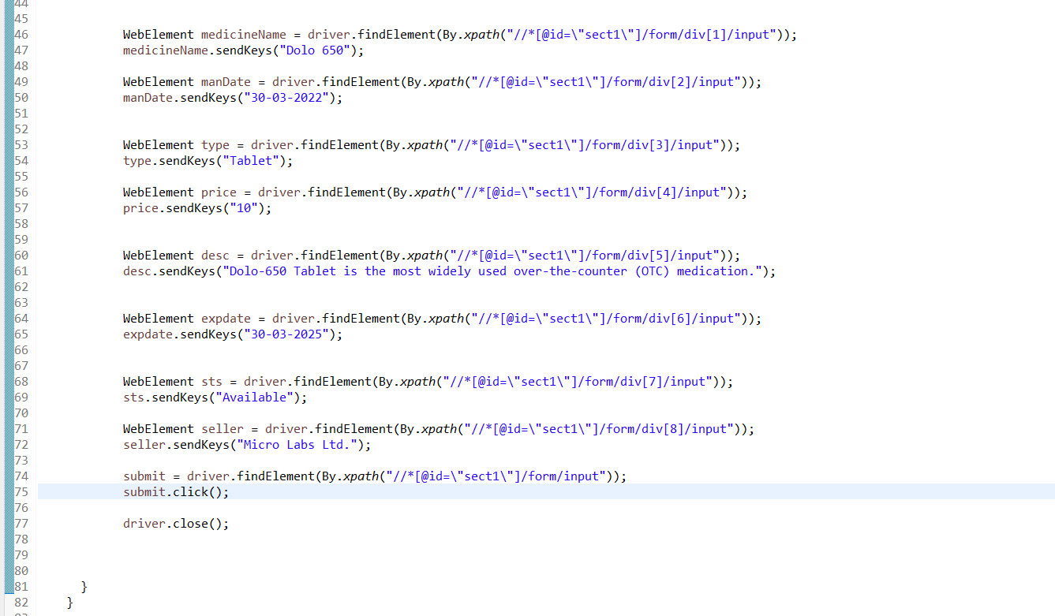

Slide 26
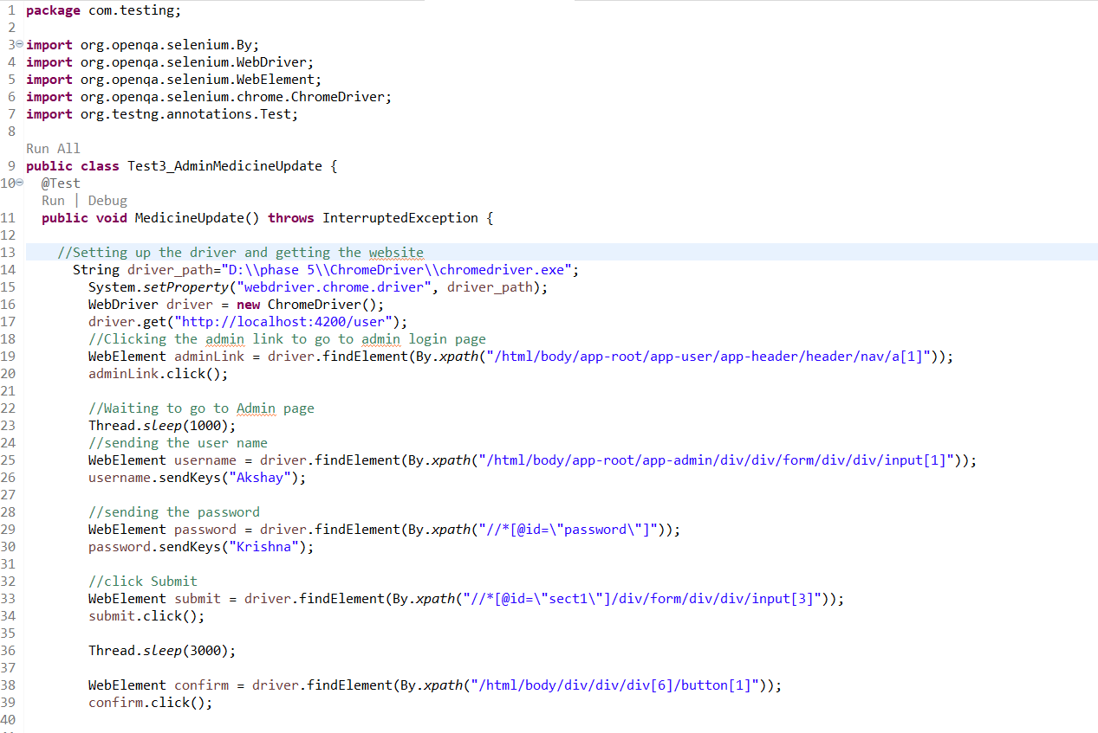
ADMIN MEDICINE UPDATE TEST

Slide 27


Slide 28
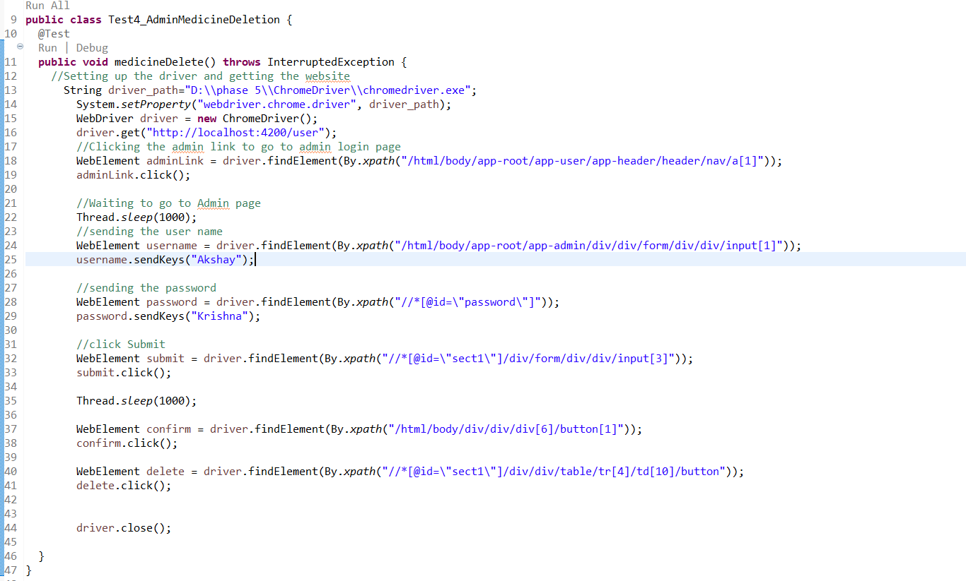
ADMIN MEDICINE DELETION

Slide 29
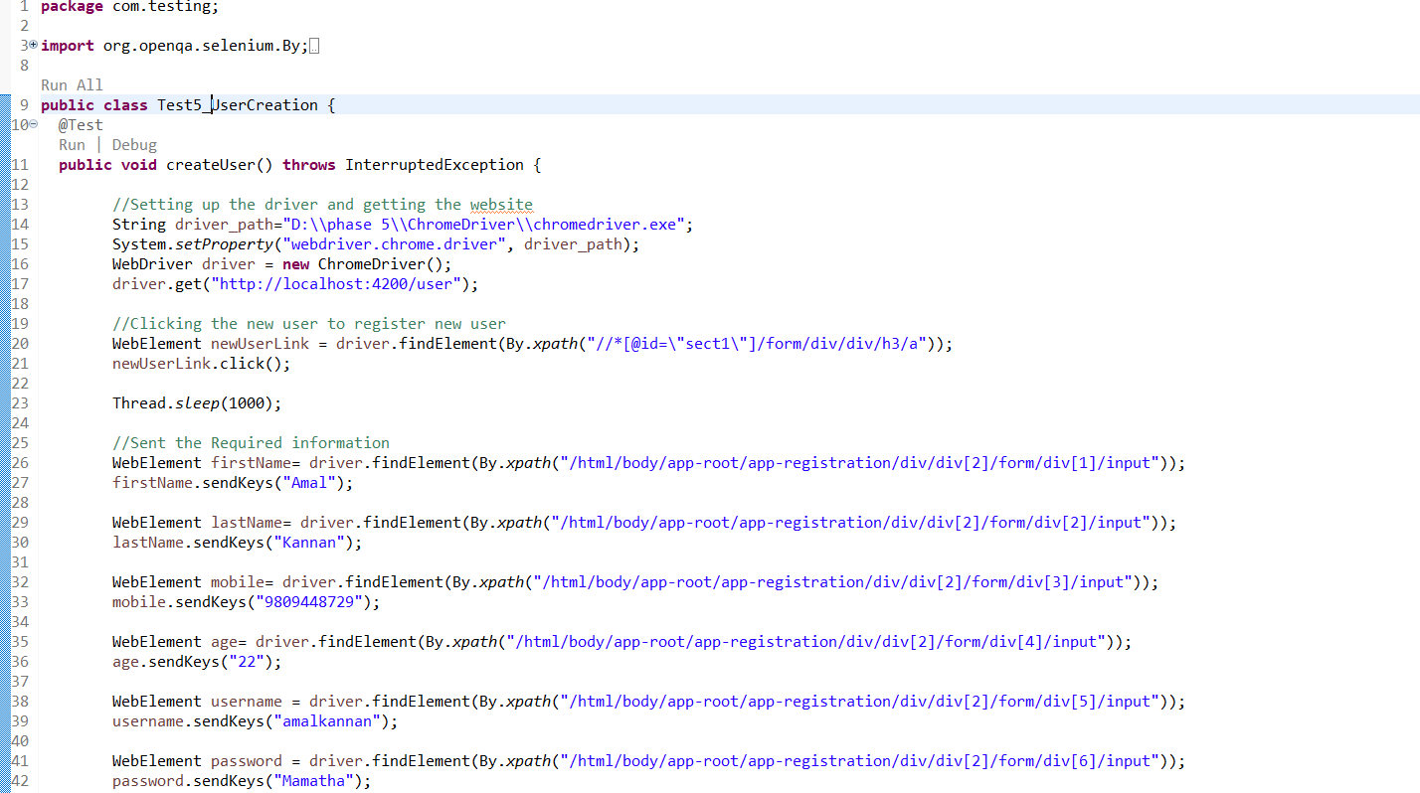
USER CREATION TEST

Slide 30


Slide 31
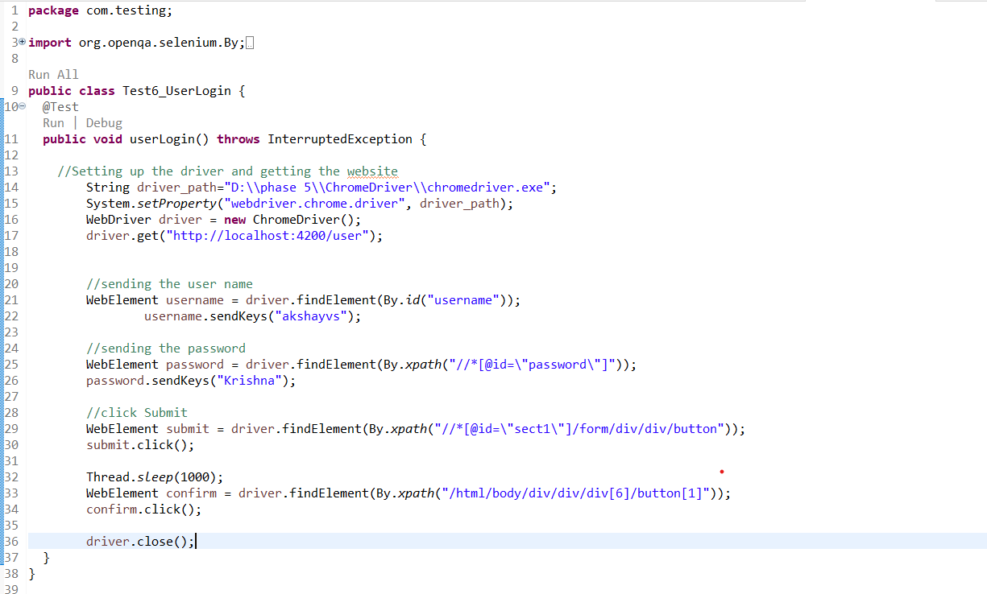
USER LOGIN

Slide 32
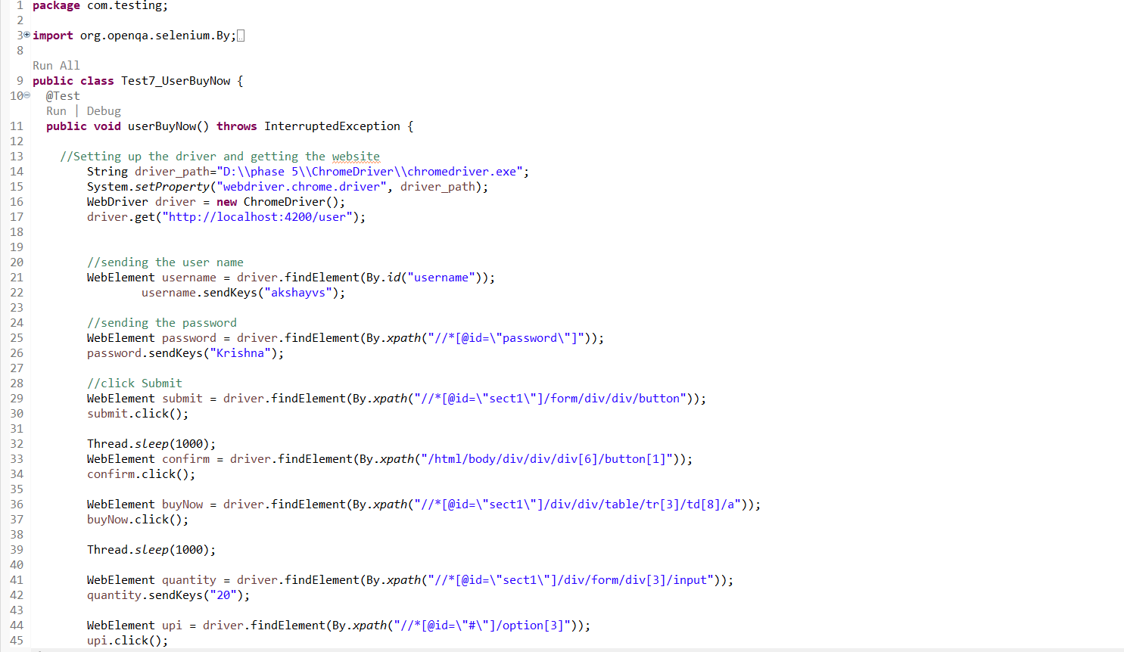
USER BUY MEDICINE TEST

Slide 33
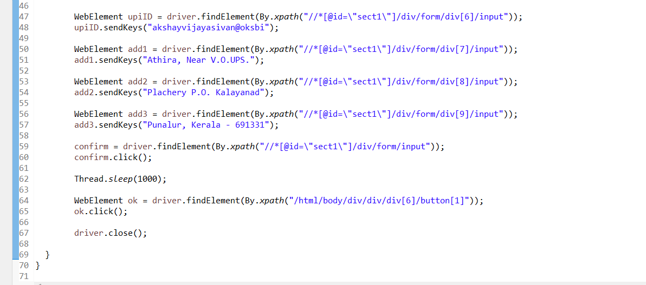

Slide 34
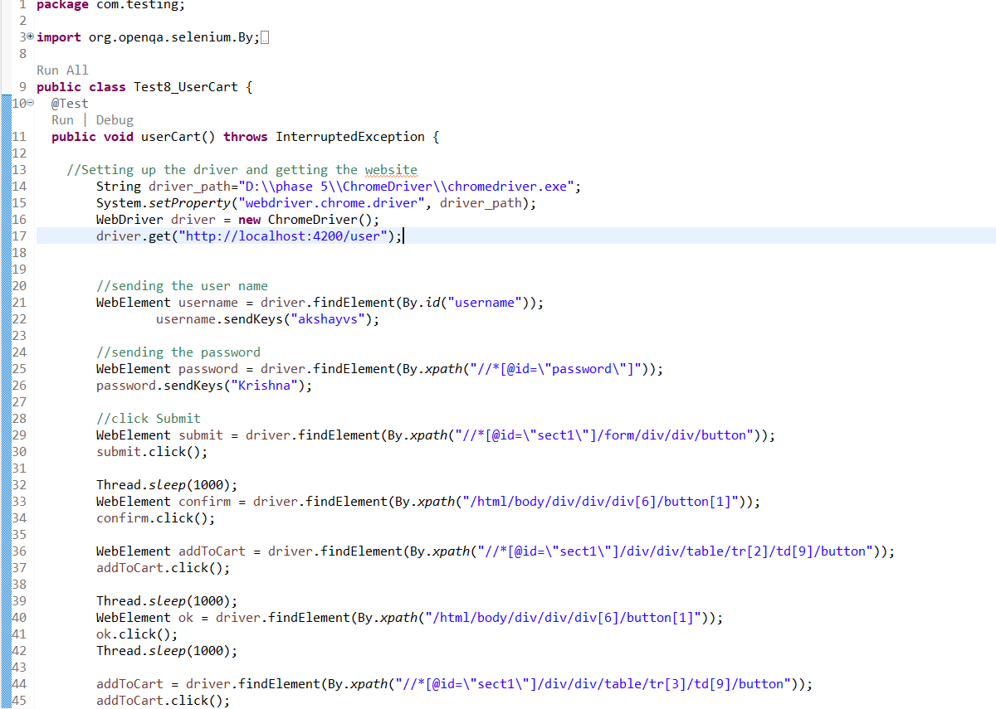
USER CART TEST

Slide 35
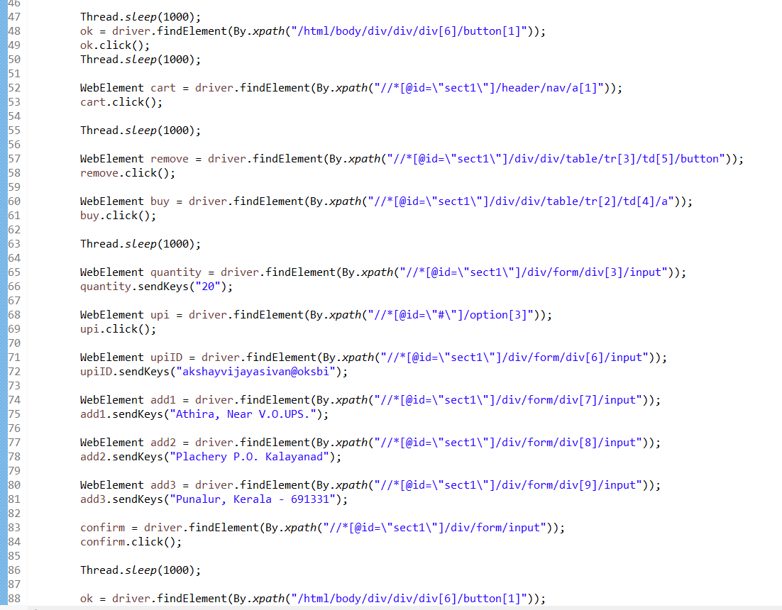

Slide 36


Slide 37
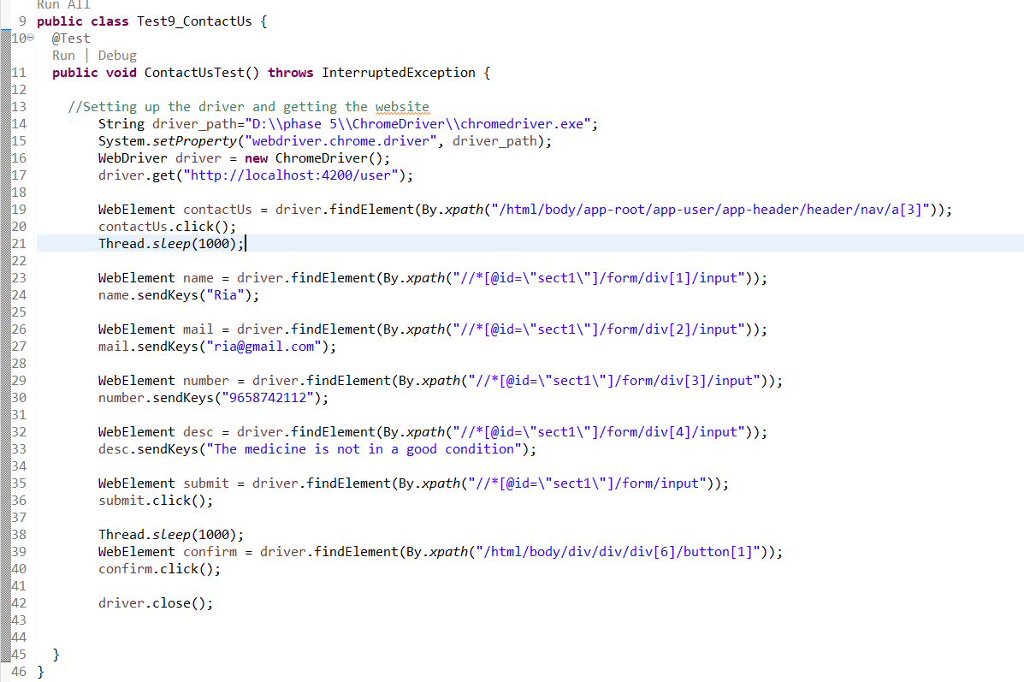
CONTACT US TEST

Slide 38
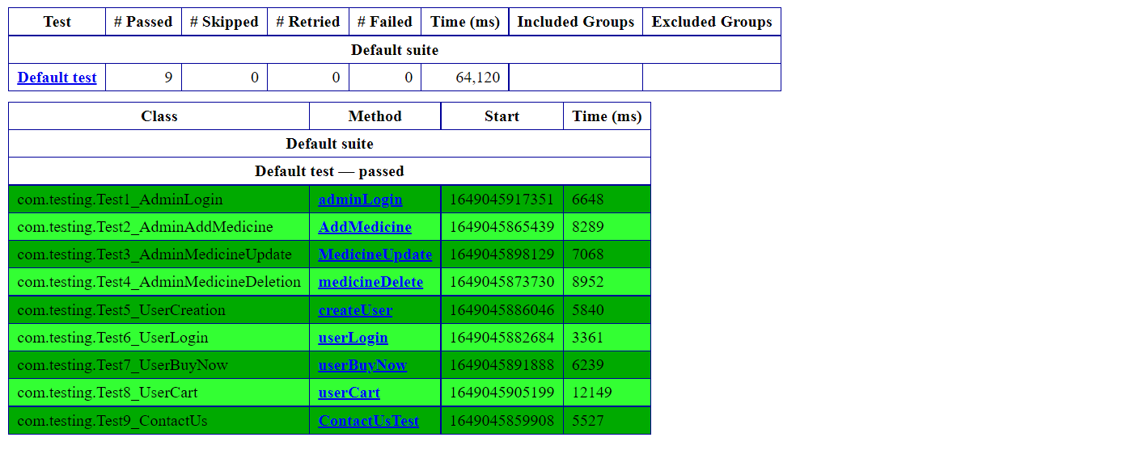
TEST REPORT

Slide 39
THANK YOU

